Slide 1
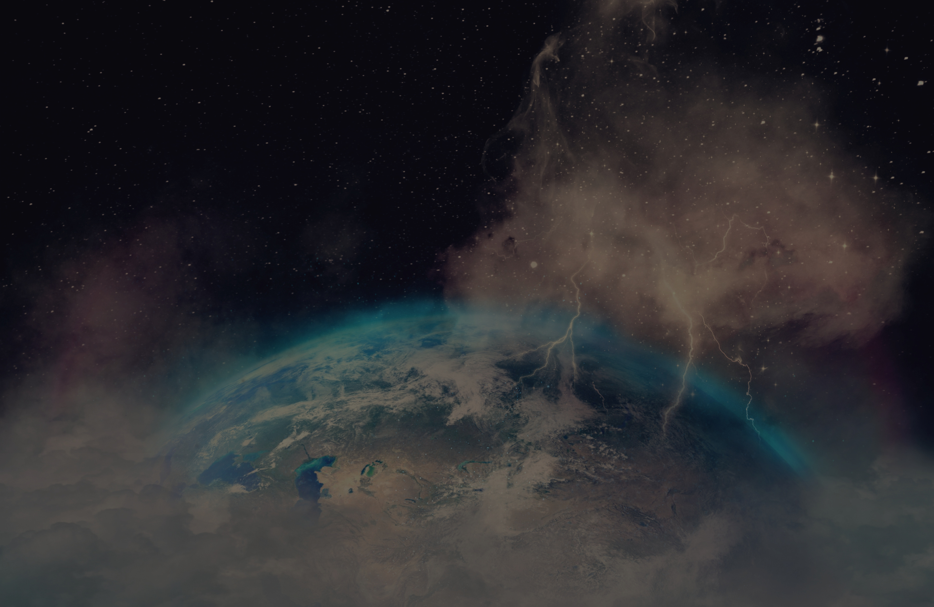

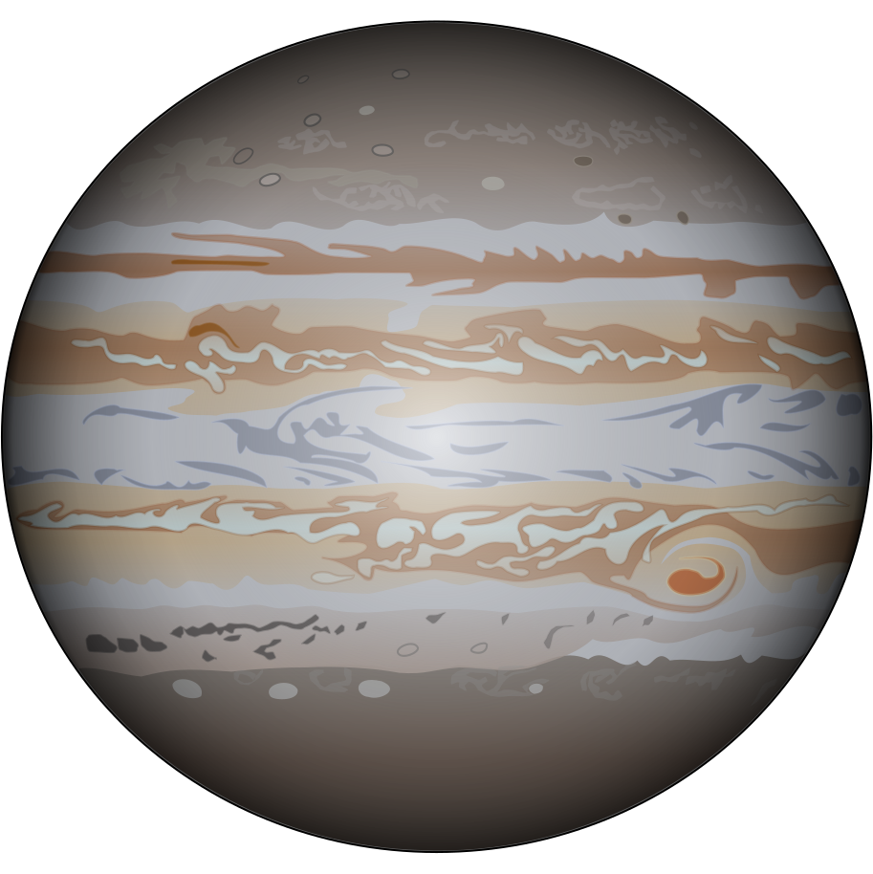


HOME
ABOUT US
INFORMATION
HNOVA
Artificial Intelligence to Discover New Worlds
Team: Arles Cerrato, Jorge Alvarez, Maria Carrasco & Luis Lainez

Slide 2
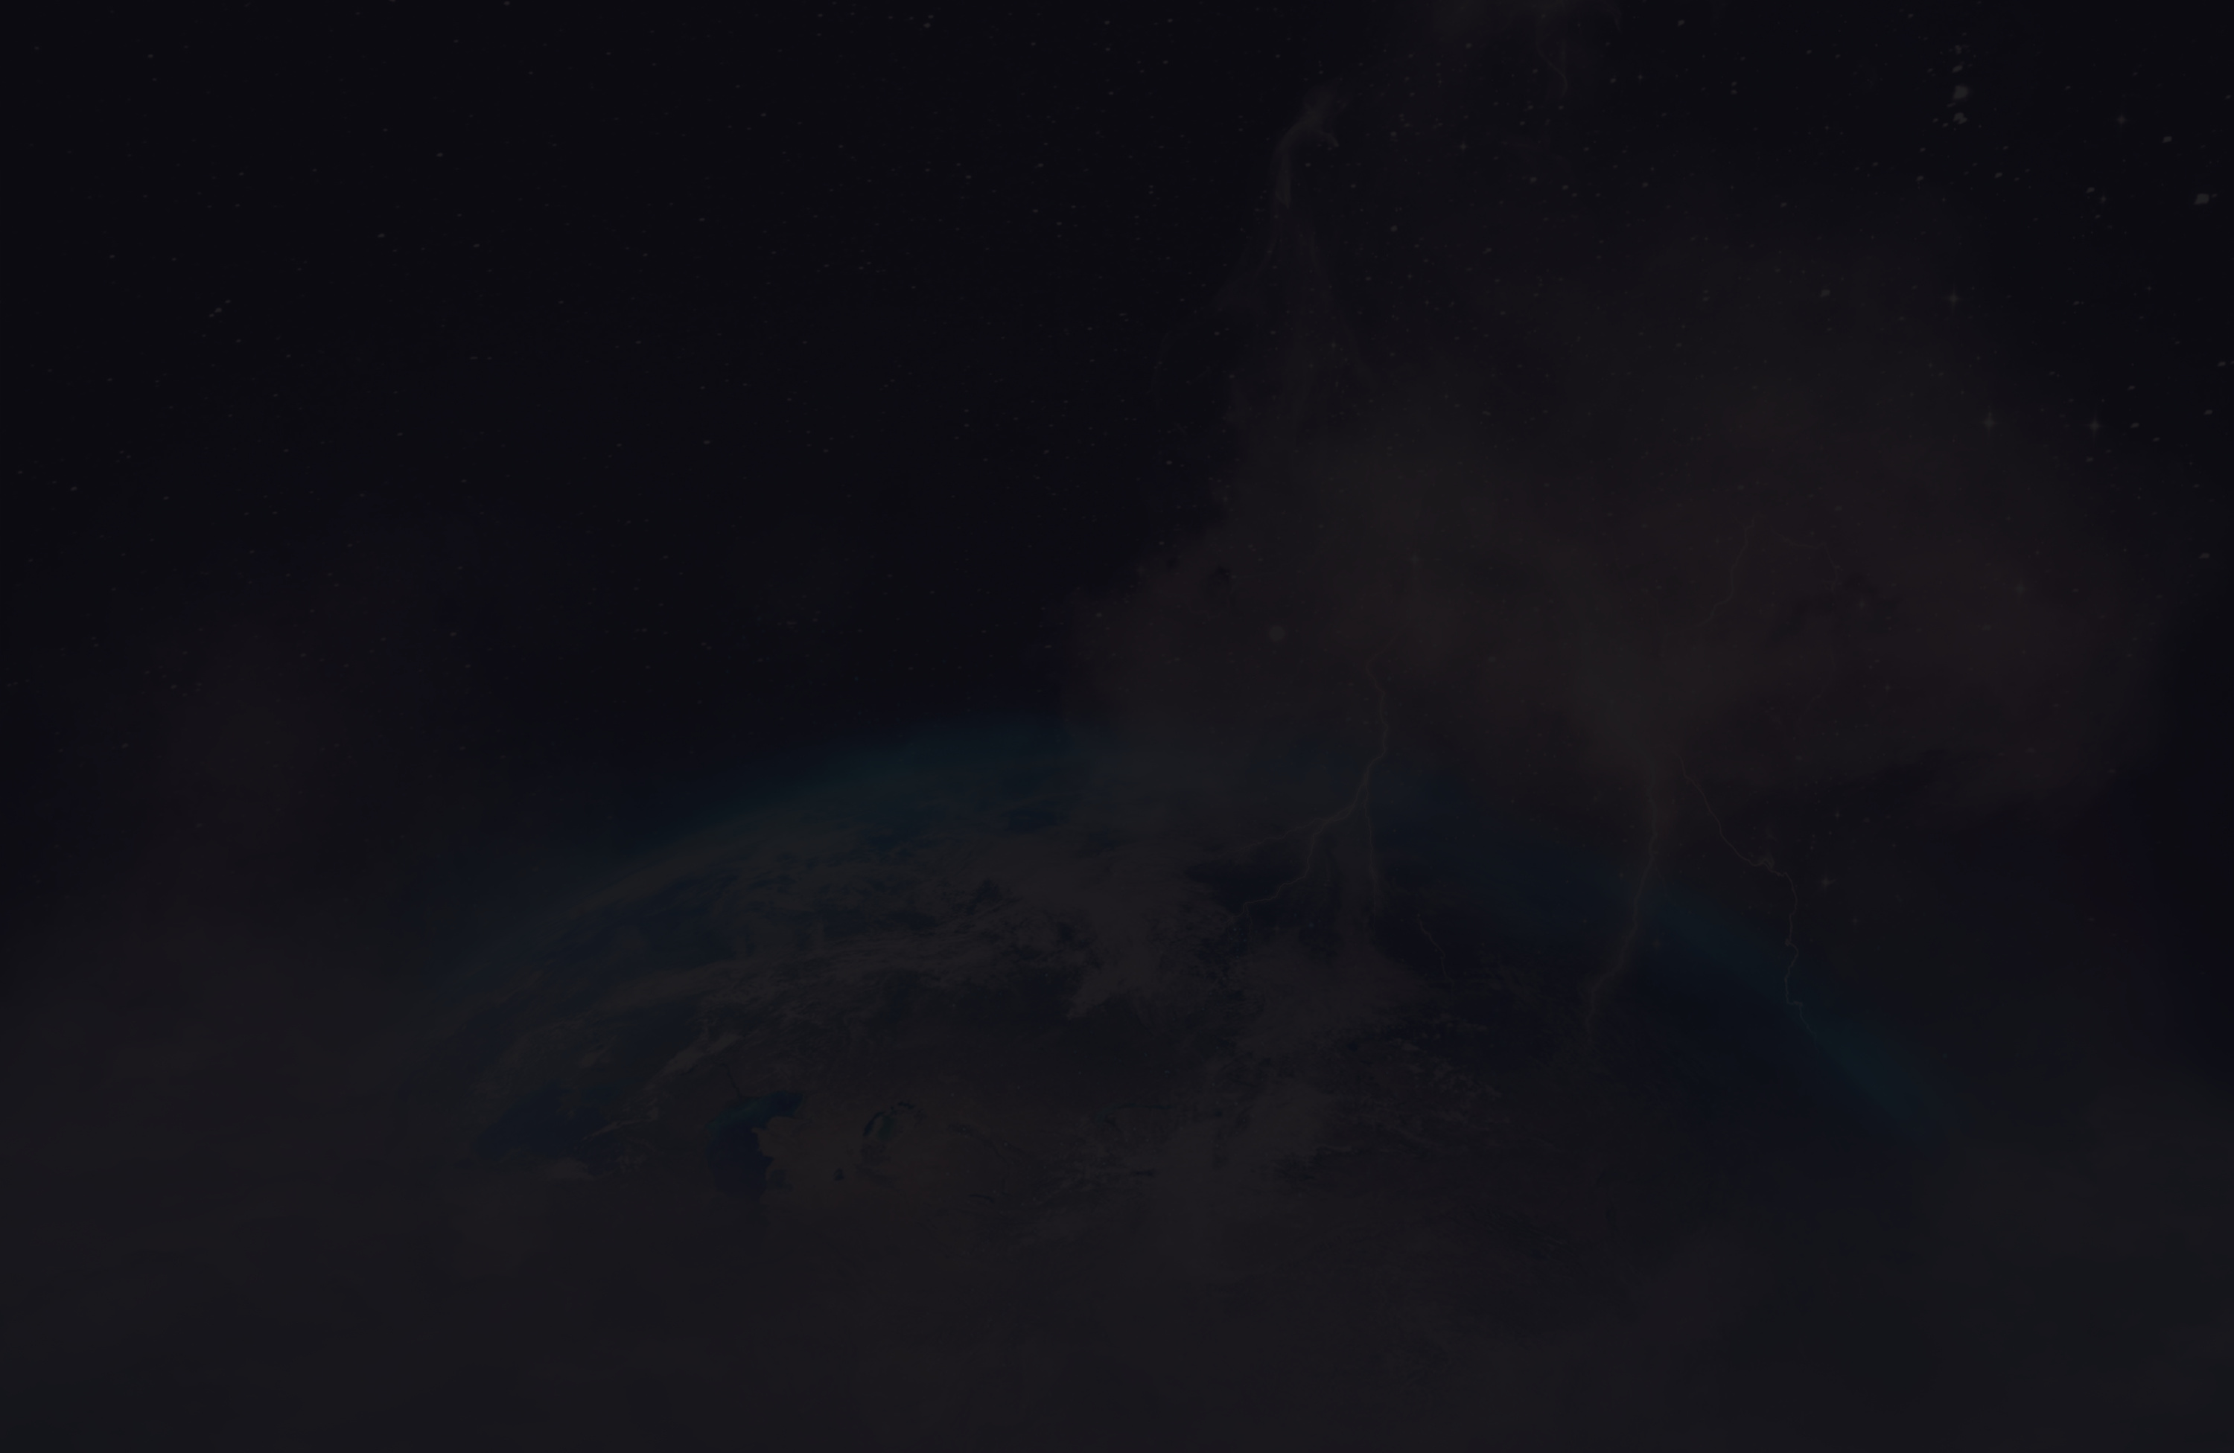
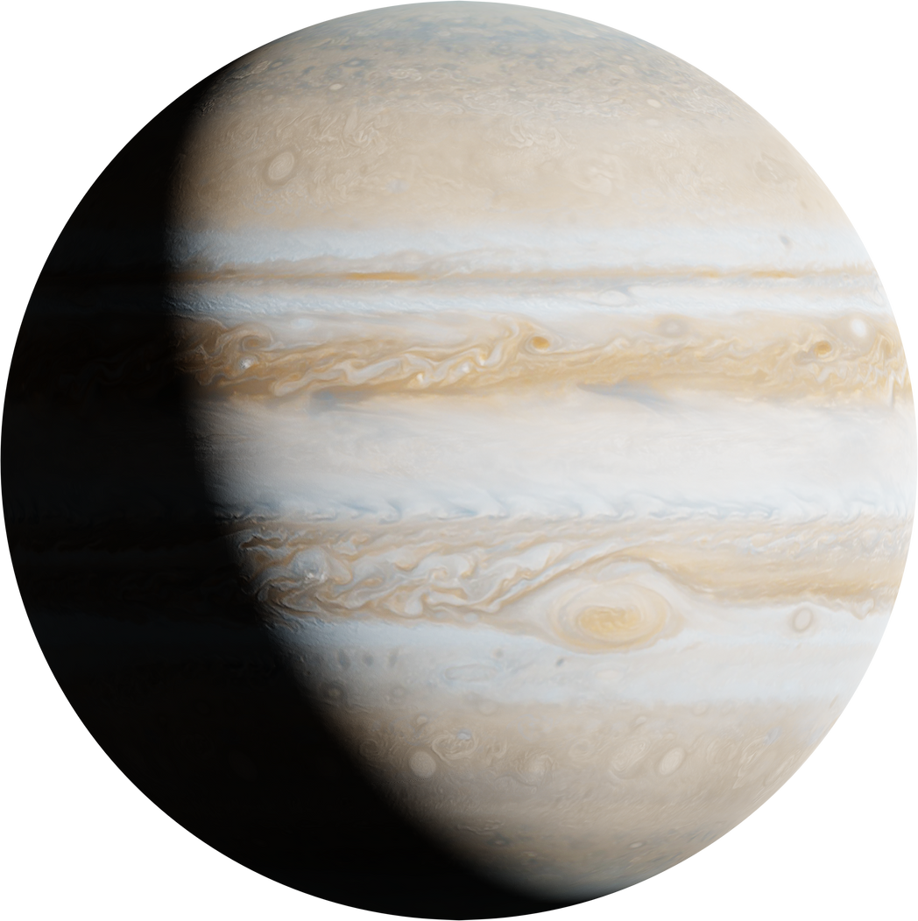
HOME
ABOUT US
INFORMATION
CONTEXT
Missions: Kepler, TESS, Gaia → millions of data points.
Thousands of unclassified candidates.
Limitations of manual or traditional analysis.
Large volume of data, low level of analysis.

Slide 3
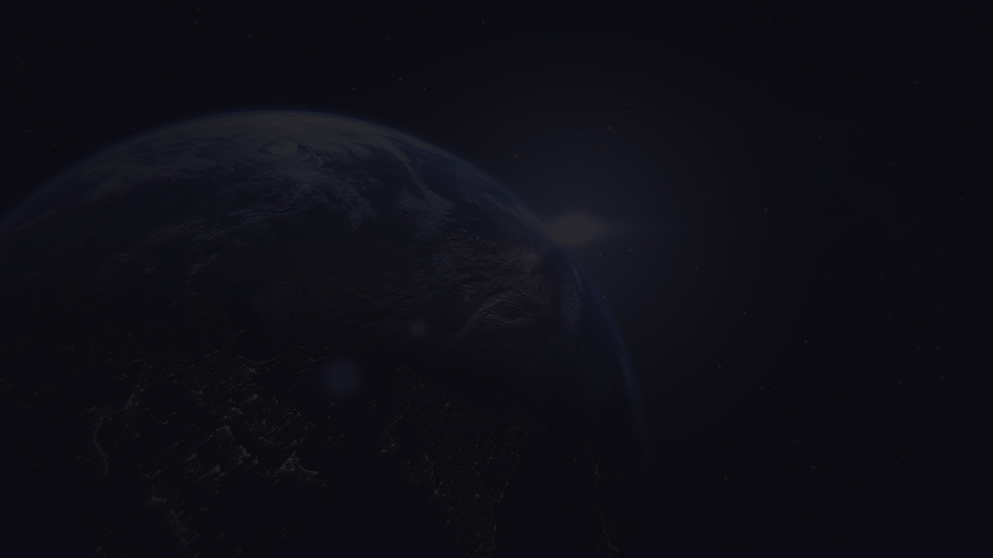
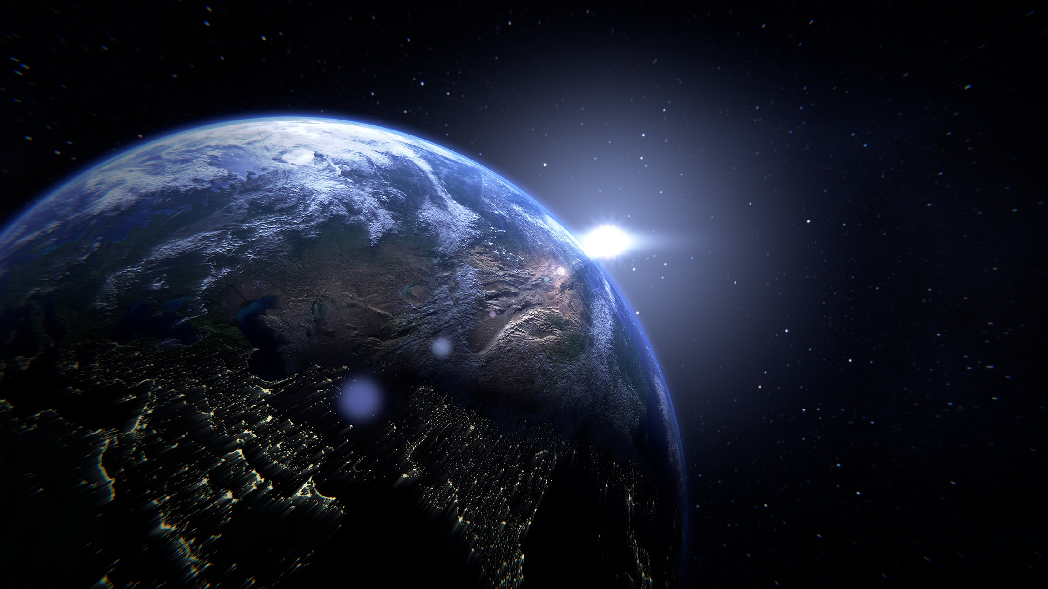
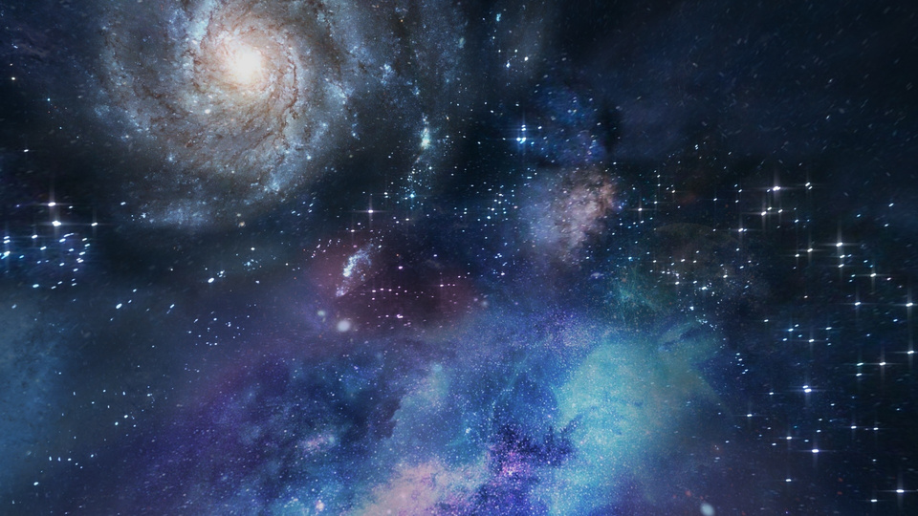
HOME
ABOUT US
INFORMATION
THE SOLUTION
HNOVA
Machine Learning model in BigQuery + Vertex AI.
Analyzes light curves, magnitude, orbital period, etc.
Automated training, predictions in seconds.
No data movement (everything in the cloud).

Slide 4
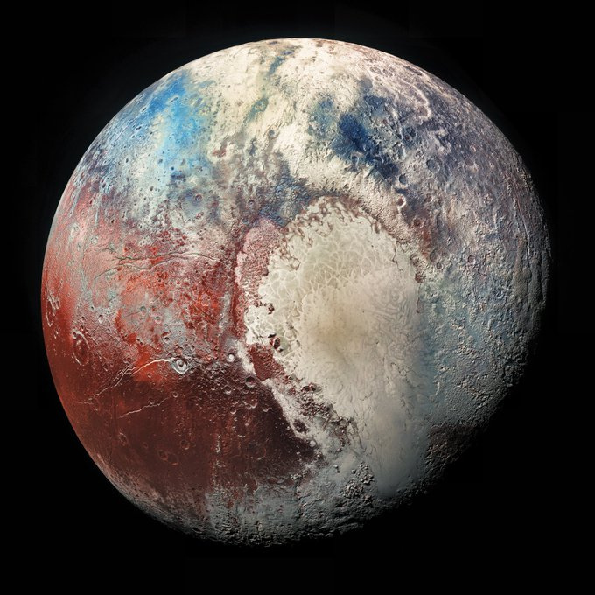
HOME
ABOUT US
INFORMATION
TECHNOLOGY
BigQuery ML: Training with SQL.
Vertex AI: Model deployment and evaluation.
Python / AutoML / Google Cloud Storage.
⚙️ Full workflow: Data → Training → Classification.

Slide 5
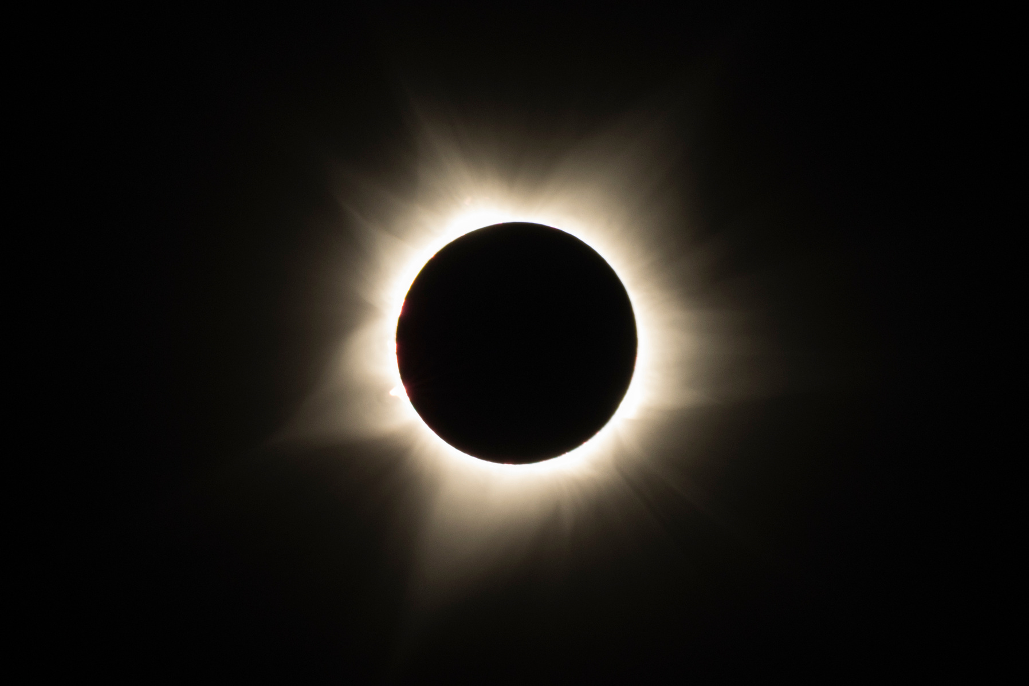

HOME
ABOUT US
INFORMATION
RESULTADOS
ESPERADOS
ACCURATE EXOPLANET CLASSIFICATION.
ACCESSIBLE AND EDUCATIONAL VISUALIZATION.
ACCELERATION OF THE SCIENTIFIC PROCESS.
SCALABILITY FOR FUTURE MISSIONS.

Slide 6
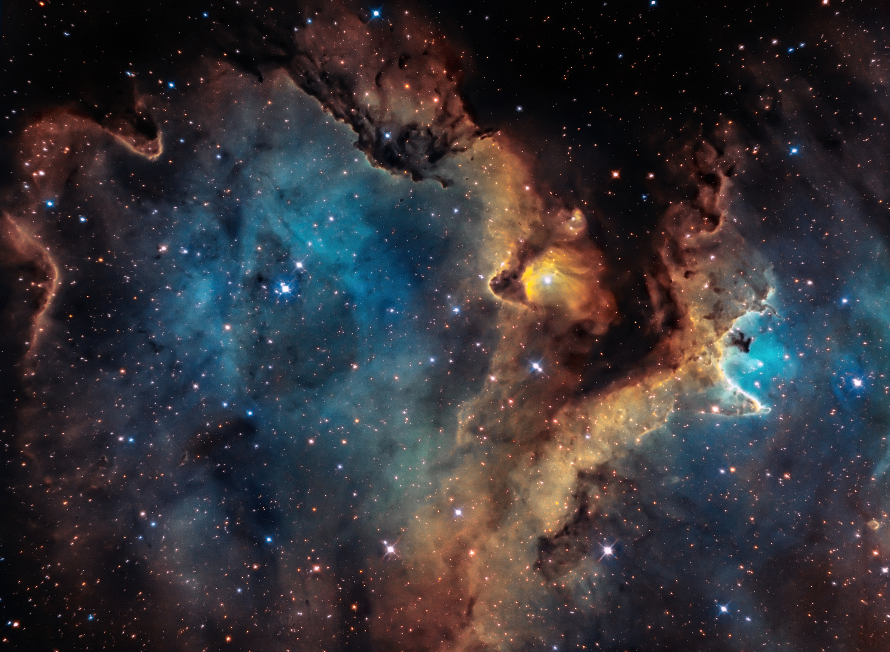
HOME
ABOUT US
INFORMATION
GLOBAL
IMPACT
🌍 SCIENCE — FASTER DISCOVERY OF NEW WORLDS.
💡 TECHNOLOGY — AI APPLIED TO SPACE DATA.
🚀 INSPIRATION — HONDURAN YOUTH PARTICIPATING IN SPACE SCIENCE.
“HNOVA: EXPLORING THE UNIVERSE WITH ARTIFICIAL INTELLIGENCE.”

Slide 7

HOME
ABOUT US
INFORMATION
THANK YOU FOR
YOUR ATTENTION

